Slide 1


STAFFEASE
EMPLOYEE MANAGEMENT SYSTEM
Guided By : Dr. P. Sammulal
Team Members:
G. Bhagyasri – 23015A503
K. Reethu – 23015A508
T. Akhila – 23015A514
MD. Suhana Tarannum – 23015A518

Slide 2



Introduction
Existing system
Proposed system
Project objectives
Technologies used
Modules
System design
Future Scope
Conclusion
A
Agenda
B
C

Slide 3
03
Introduction
Efficient employee management is crucial in any organization to ensure smooth operations, optimal productivity, and effective communication. In today's digital era, manual record-keeping is both time-consuming and error-prone.
This project addresses these challenges by providing a user-friendly Employee Management System that automates key HR functions such as employee data tracking, attendance, role assignments, and performance monitoring. Our system aims to enhance administrative efficiency and accuracy, while reducing paperwork and operational delays

Slide 4
03
Existing System
The earlier system is a manual process.
It is time-consuming for all processes.
It requires more resources (human effort and paperwork).
There is a chance of losing record details or misplacing important data.

Slide 5
03
Disadvantages Of Existing System
It is time consuming​
It consumes lot of manpower to better results​
It lacks of data security​
Retrieval of data takes lot of time​
Percentage of accuracy is less​
Reports take time to produce

Slide 6
03
Proposed System
This system streamlines administrative /HR processes for efficient management.
Its reduced time consume.
And admin updated all details to employee with through this system.
Employee also can able to apply leave through this system.
And they can view task for a day after completing their own task that details also can updated by employee.

Slide 7
03
Advantages Of Proposed System
The Project has several features and easy to manage.
The System is user friendly.
Cost effective.
Back up support.
Secured Data.

Slide 8
03
Project Objectives
To streamline the leave approval process through an automated leave management system.
To enhance recruitment efficiency using AI-powered resume analysis with NLP techniques.
To monitor employee satisfaction by implementing monthly sentiment analysis.
To promote workplace transparency through a Raise Your Voice feature.
To provide HR with detailed, real-time reports of employees.
To support informed decision-making through data visualization and intelligent search tools.
To ensure ease of use through an intuitive and user-friendly interface.
To maintain data security and access control via role-based user permissions.

Slide 9
03
Technologies Used
Frontend:
ReactJS (JavaScript library for building dynamic user interfaces)
Axios (for API integration)
HTML5, CSS3 (structure and styling)
Charting libraries (e.g., Recharts) for visualizations
Backend:
Node.js (server-side runtime)
Express.js (backend framework for handling routes and APIs)
bcryptjs (for password hashing and security)
JSON Web Token (JWT) for authentication
Database:
MongoDB (NoSQL database to store employee data, leave requests, feedback, etc.)
Mongoose (ODM library for MongoDB)

Slide 10
03
Modules
Authentication Module
User Management Module
Resume Checker Module
Leave Management Module
Feedback Sentiment Analysis Module
Reports Module
Complaints Module
Statemen

Slide 11
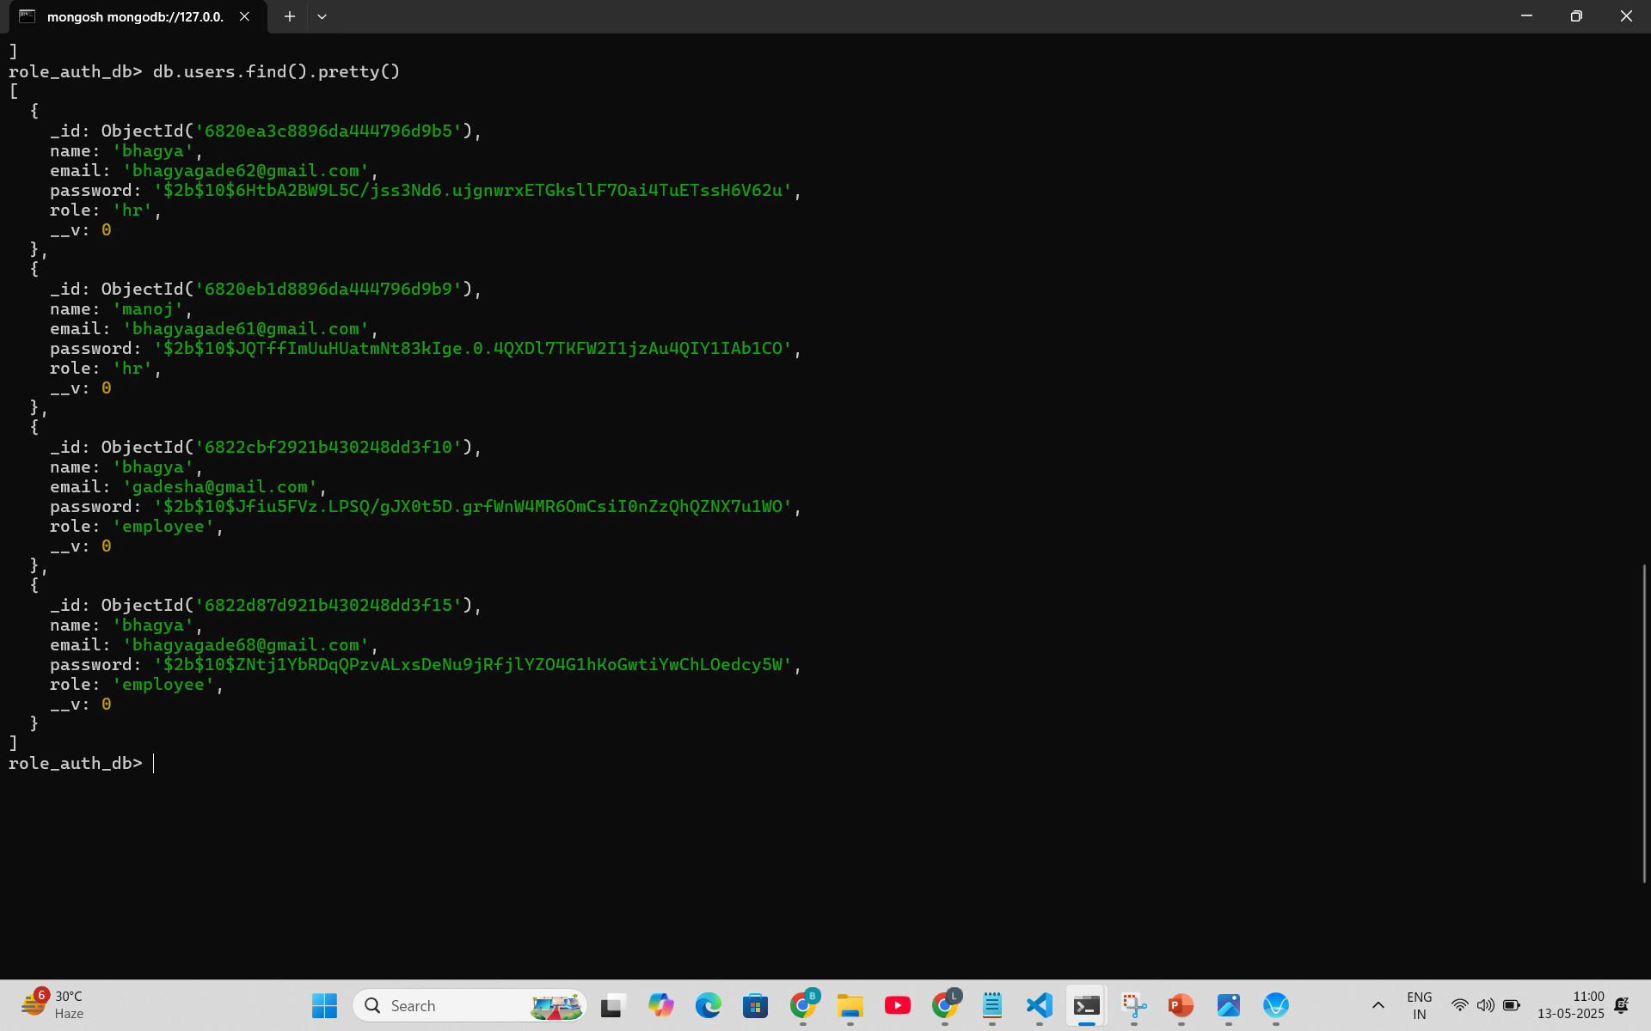
03
Authentication Module
Handles user login and registration
Implements secure authentication using JWT
Ensures role-based access (Admin, HR, Employee)
API Endpoints:
POST /api/auth/login – User login (returns JWT)

Slide 12
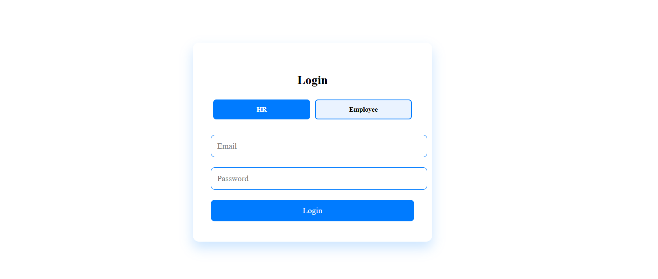
03
Authentication Module

Slide 13
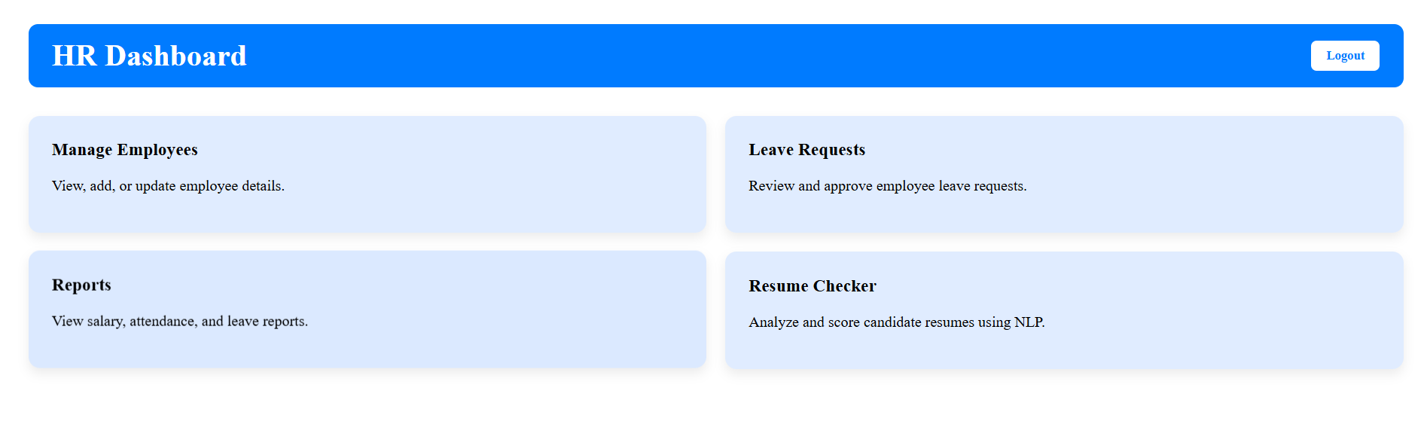
03
HR Dashboard

Slide 14
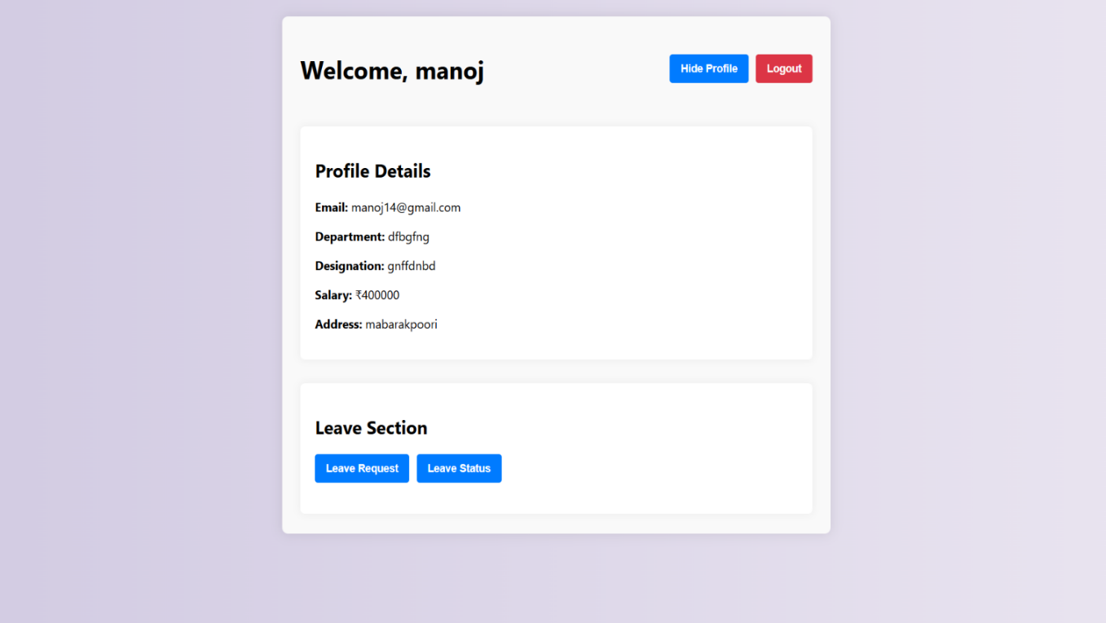
03
Employee Dashboard

Slide 15
03
User Management Module
Allows Admin/HR to add, edit, and delete employee records
Manages roles and access rights
Displays employee profile details
API Endpoints:
POST /api/hr/add-employee – Add employee with encryption
PUT /api/hr/update-employee – Update employee info
DELETE /api/hr/delete-employee – Delete employee by email
GET /api/hr/get-employees – Fetch all employees

Slide 16
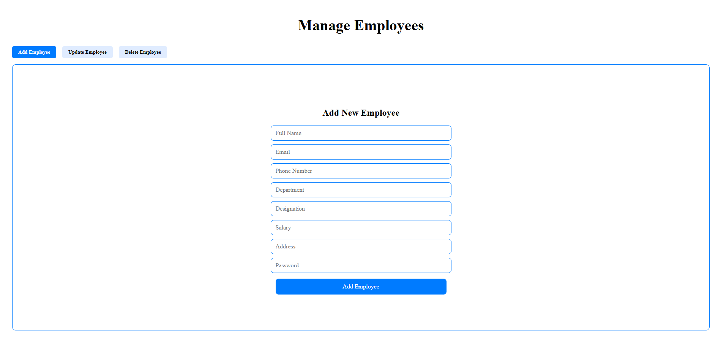
03
Adding Employees

Slide 17
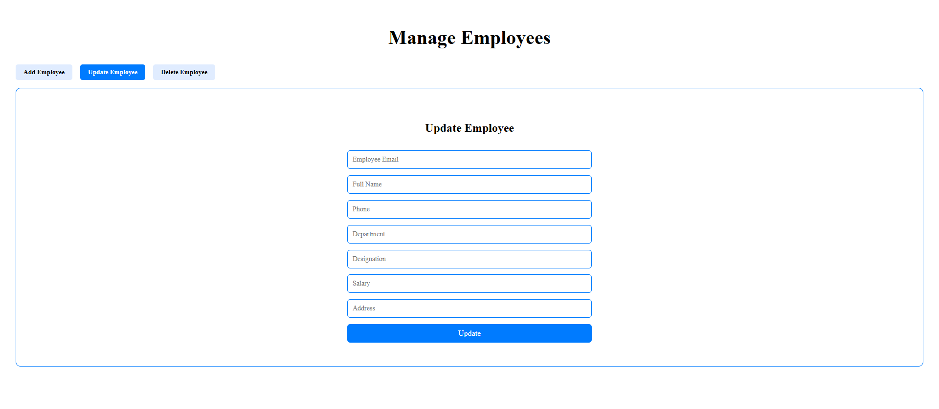
03
Updating Employees

Slide 18
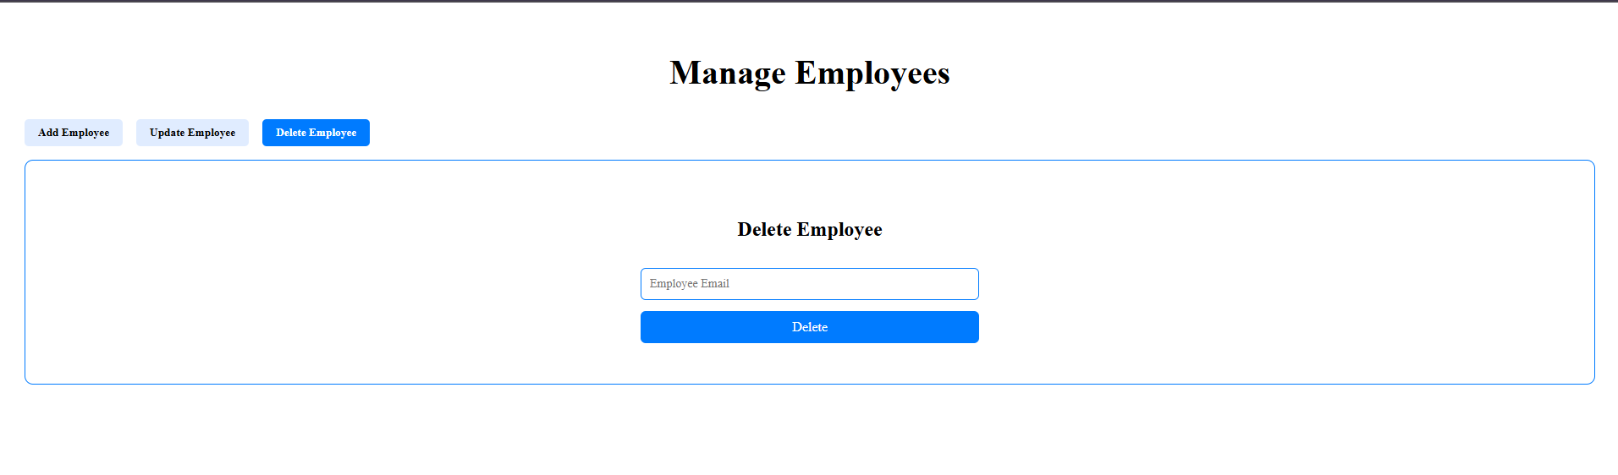
03
Deleting Employees

Slide 19
03
Resume Checker Module
Allows HR or Admin to upload and analyze resumes.
Assigns a compatibility score (e.g., matching percentage).
Displays analysis result in the dashboard.
API Endpoints:
POST /api/resume/check – Analyze uploaded resume, match with job description and required skills

Slide 20
03
Resume Checker Module
Objectives:
To automate initial resume screening
To reduce manual effort for HR
To filter unqualified applicants
To give instant feedback on resume relevance
Key Functionalities:
User uploads resume + enters JD & skills
Backend reads the file using pdf-parse (PDF) or mammoth (DOCX)
Extracted text is cleaned and lowercased
Resume content is compared with skills & JD
Score is calculated based on matches
Feedback and matched skills are generated
Frontend shows result to user

Slide 21
03
Resume Checker Module
Advantages:
Fast and accurate skill-based filtering
Works for both PDF and DOCX formats
Saves HR time during recruitment
Can be extended for bulk resume screening

Slide 22
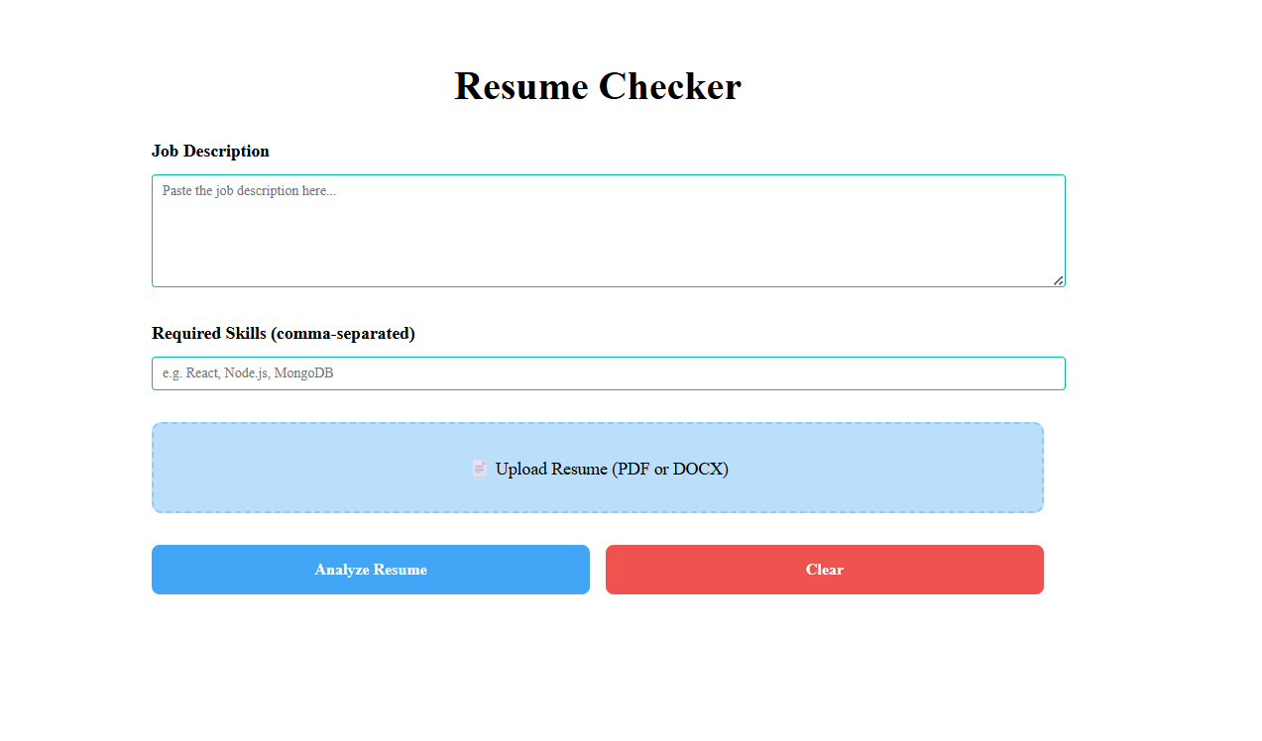
03
Resume Checker Module

Slide 23
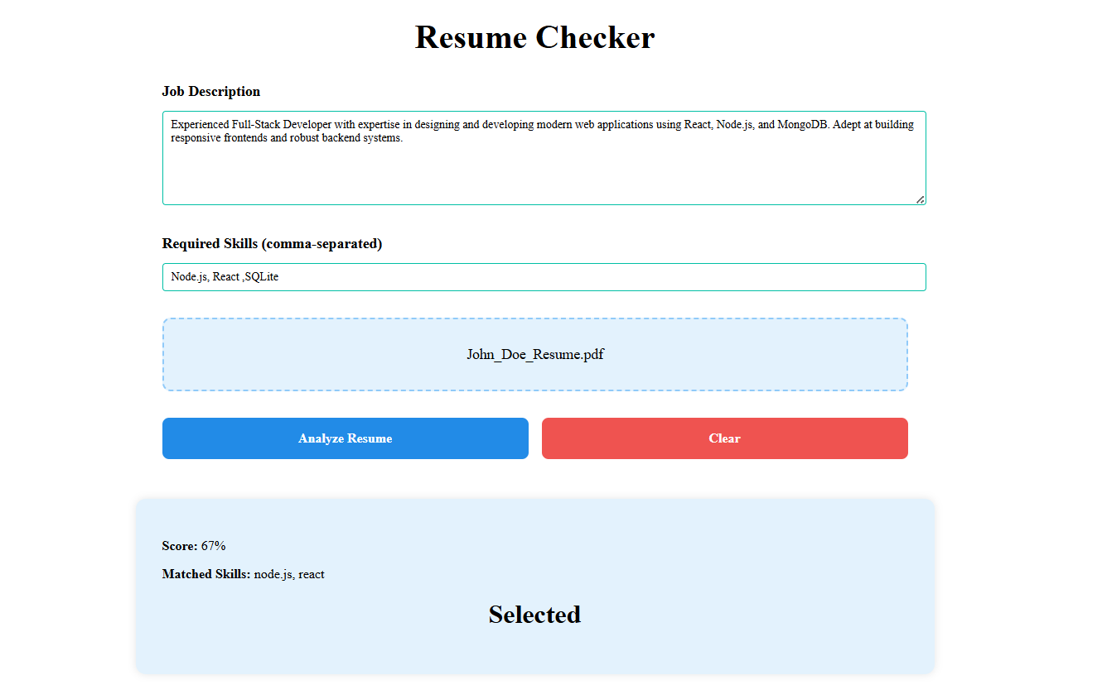
03
If Selected:

Slide 24
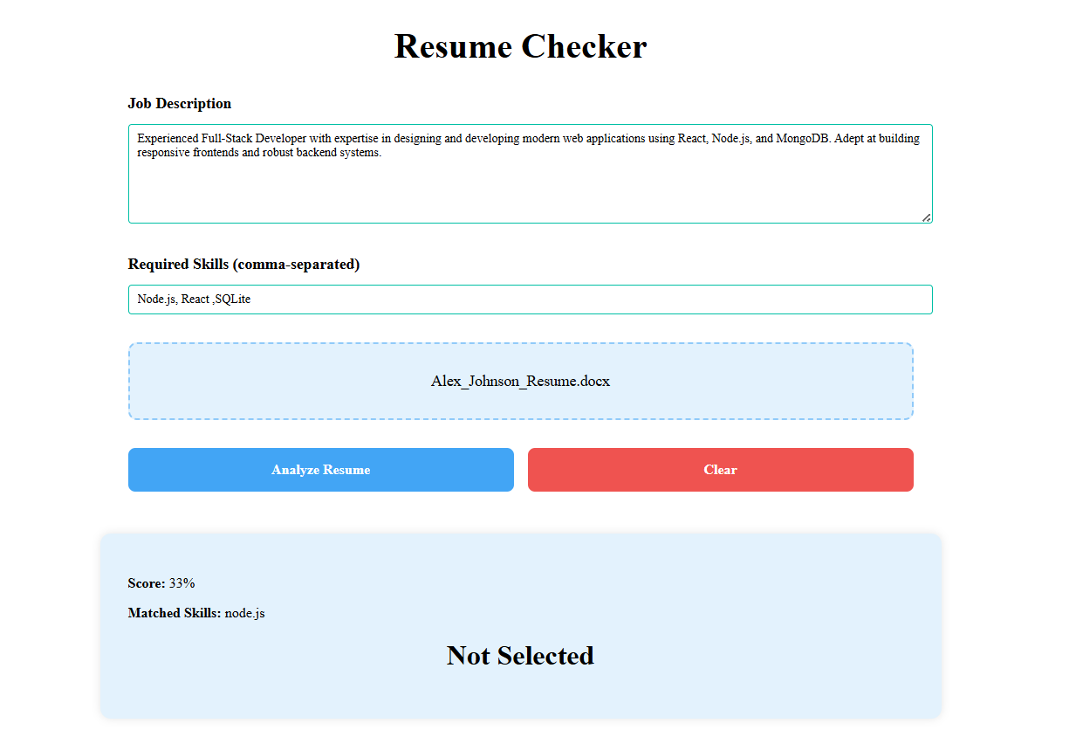
03
If Not Selected:

Slide 25
03
Leave Management Module
Employees can apply for leave
Admin/HR can approve or reject leave requests
Maintains leave history and status
API Endpoints:
POST /api/leaves/request-leave – Submit leave request
GET /api/leaves/get-leaves – HR fetches all requests
PATCH /api/leaves/update-leave-status – HR updates status
GET /api/leaves/monthly-leave-count – Track employee's monthly leave

Slide 26
03
Leave Management Module
- New Feature : AI-inspired decision support
Added a decision support feature to help HR quickly decide to approve or reject employee leave requests.
Inspired by AI concepts — currently implemented as a rule-based logic system.
Developed using :
React hooks
JavaScript date functions
Axios for API calls.
Used custom business rules (expert system style).
Our expert logic:
Count how many leaves were already approved for the employee in that month.
If approved leaves < 2, suggest Approve
Otherwise, suggest Reject

Slide 27
03
Leave Management Module
- New Feature : AI-inspired decision support
Displays "AI Suggests: Approve" or "AI Suggests: Reject" next to each pending leave request.
HR can still take the final decision manually.
Improves decision speed and consistency.
Advantages:
Reduces manual decision-making time.
Provides a data-driven suggestion, reducing human bias.
Easy to upgrade in future to real ML-based predictions.

Slide 28
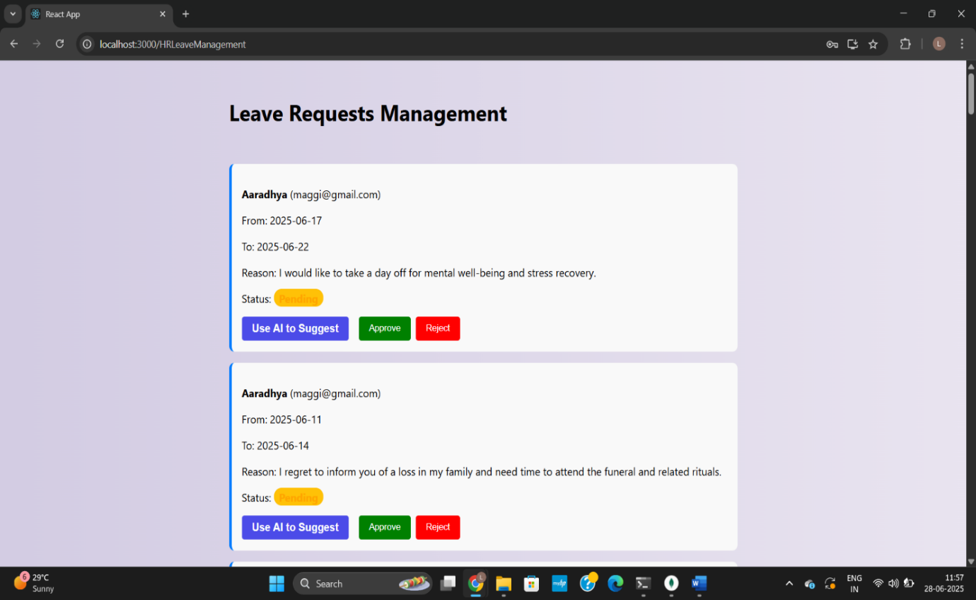
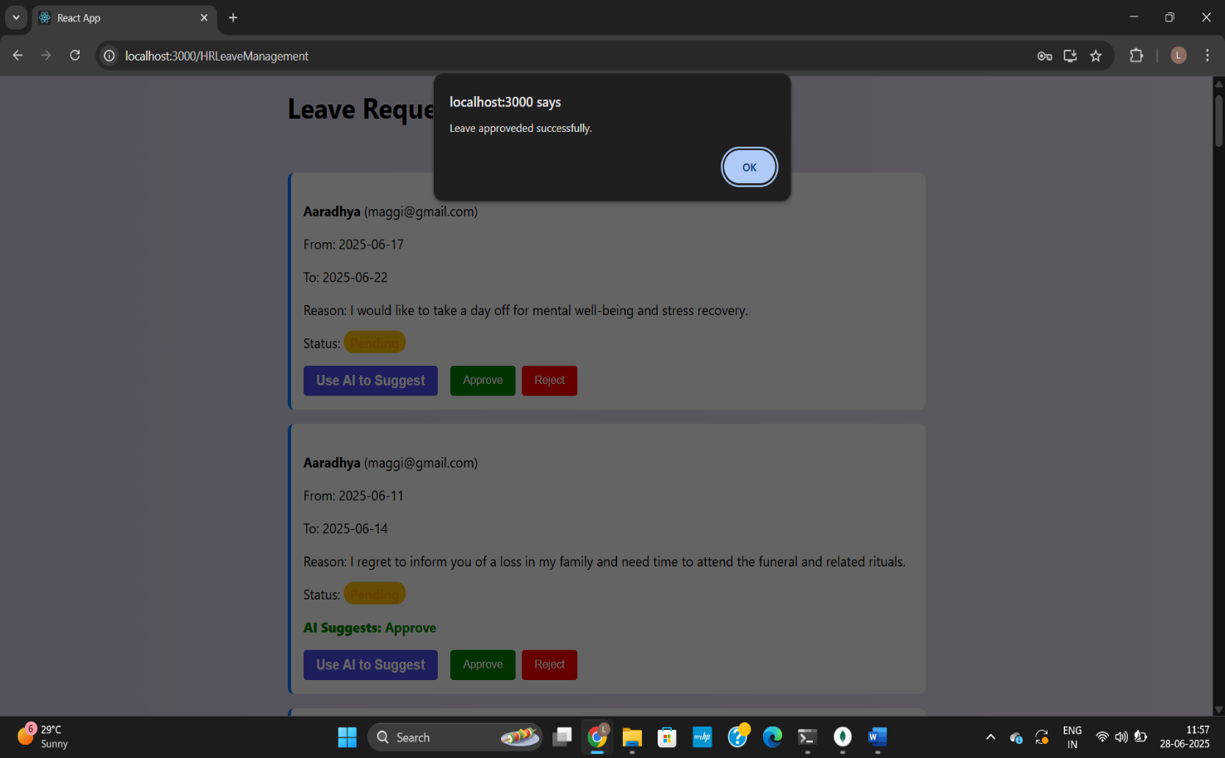
03
Leave Management Module

Slide 29
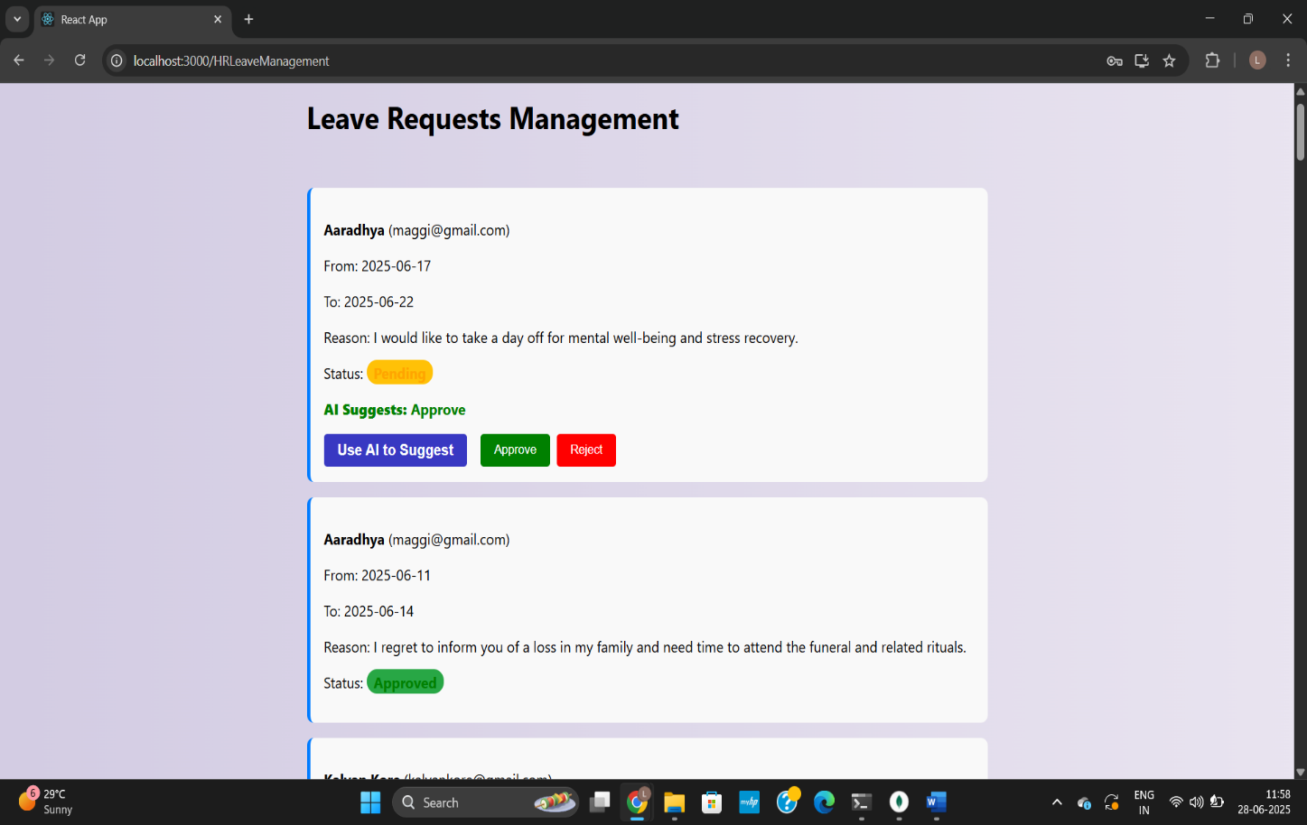
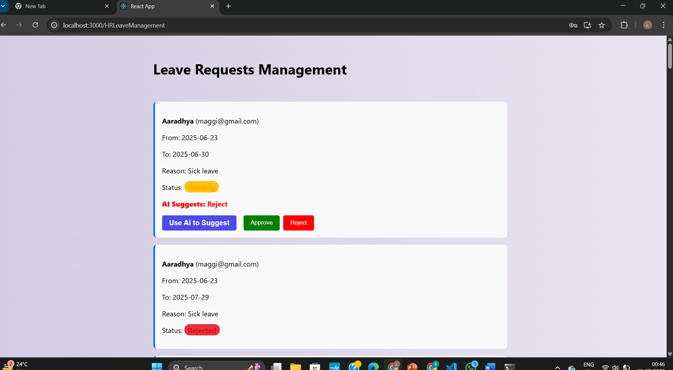
03
Leave Management Module

Slide 30
03
Feedback Sentiment Analysis Module
Allows employees to submit monthly feedback through their dashboard.
System analyzes feedback sentiment as Positive, Neutral, or Negative.
Helps HR understand overall employee morale and satisfaction.
Employees enter text feedback in the frontend (React form).
Feedback is sent to backend API (Node.js + Express).
On the backend, we use a sentiment analysis library sentiment npm package (lightweight, open source).
The library calculates a sentiment score.
Store feedback text and sentiment result in MongoDB.
API Endpoints:
GET /api/feedback/sentiment-stats – HR sentiment chart data

Slide 31
03
Feedback Sentiment Analysis Module
HR dashboard displays a summary chart (e.g., pie chart) showing:
Positive feedback
Neutral feedback
Negative feedback
Benefits:
Helps HR take proactive actions.
Builds a transparent and healthy work culture.
Encourages employees to share honest feedback

Slide 32
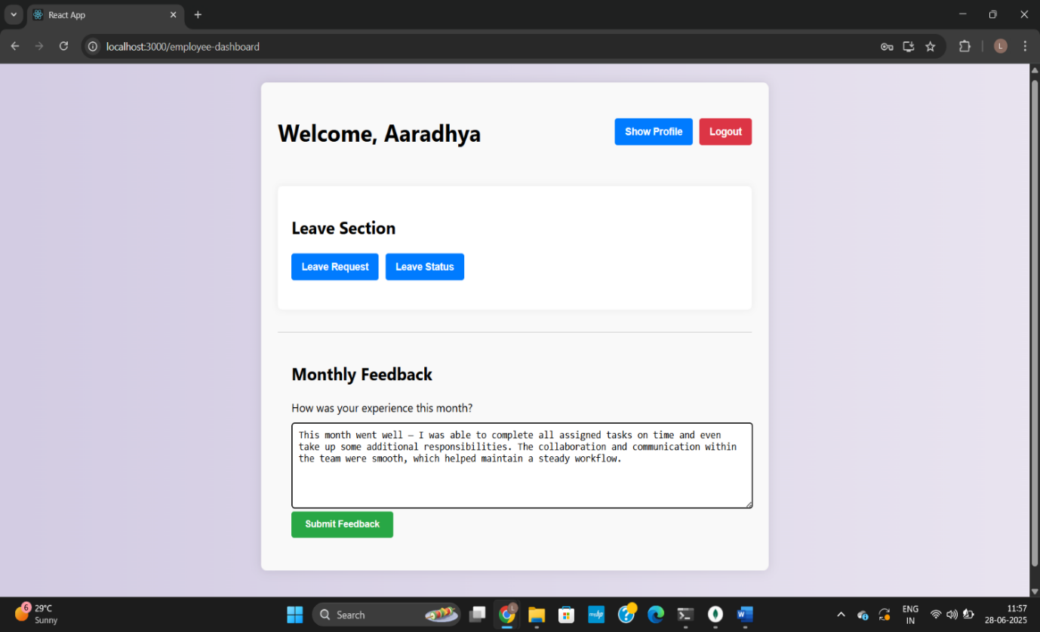
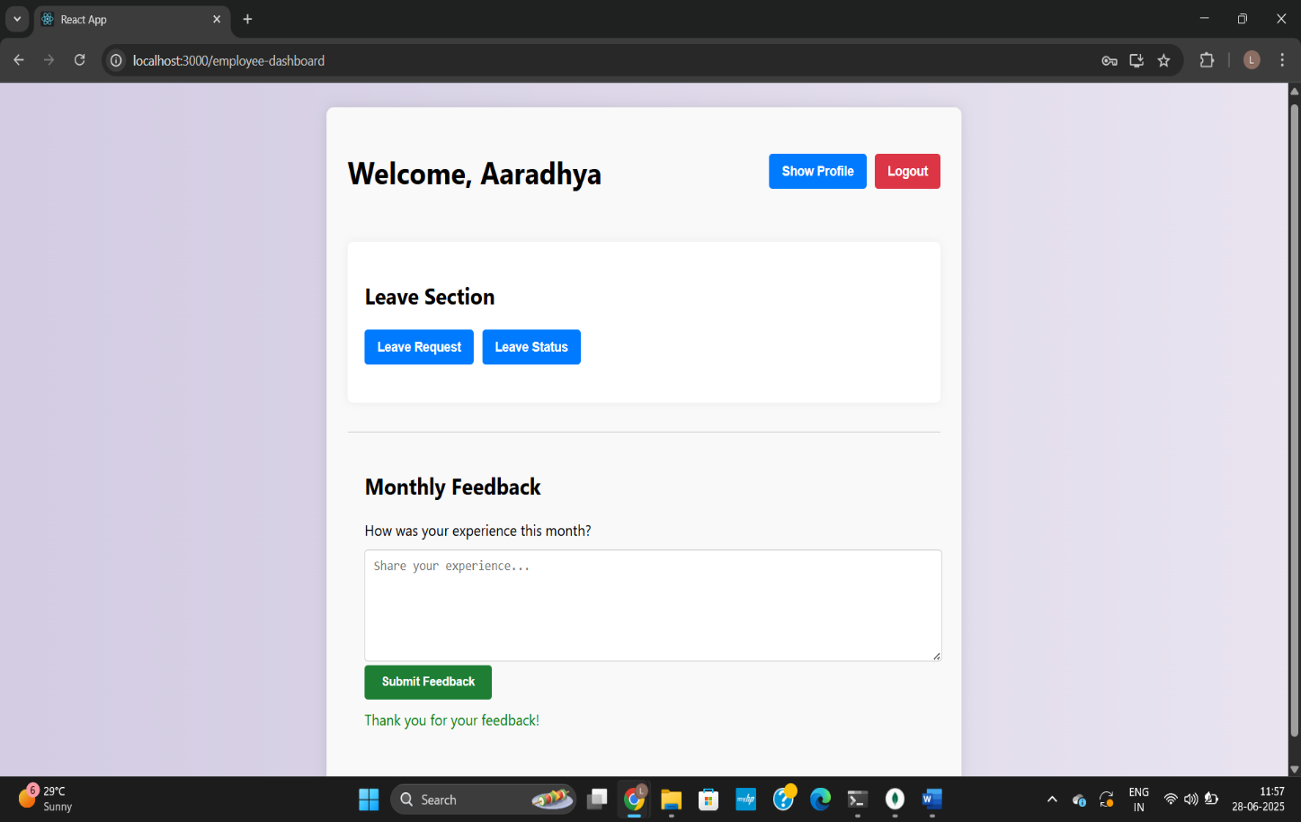
03
Feedback Sentiment Analysis Module

Slide 33
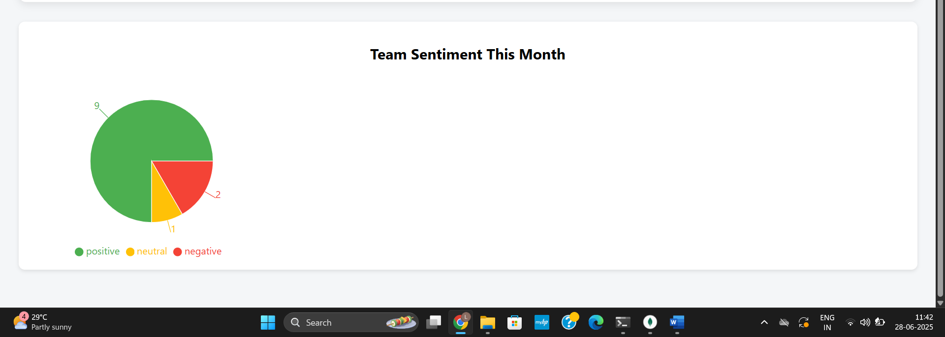
03
Feedback Sentiment Analysis Module
HR Dashboard

Slide 34
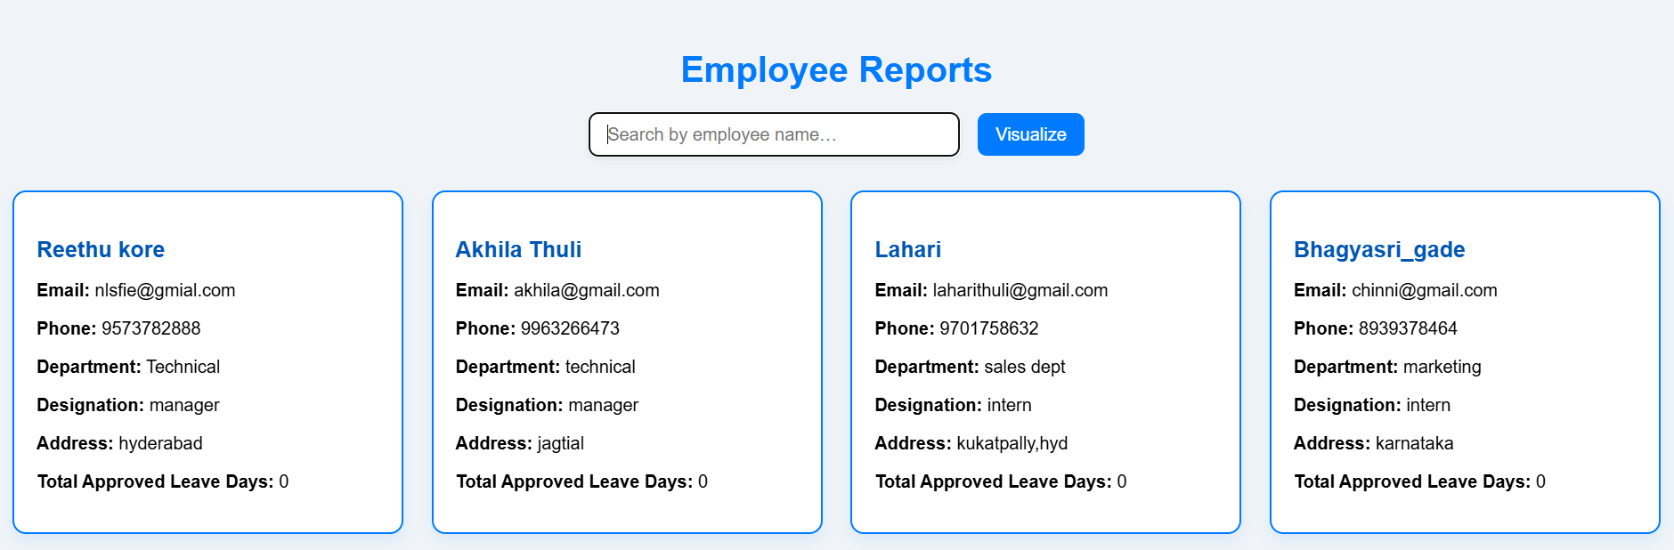
03
Reports Module
HR dashboard:

Slide 35
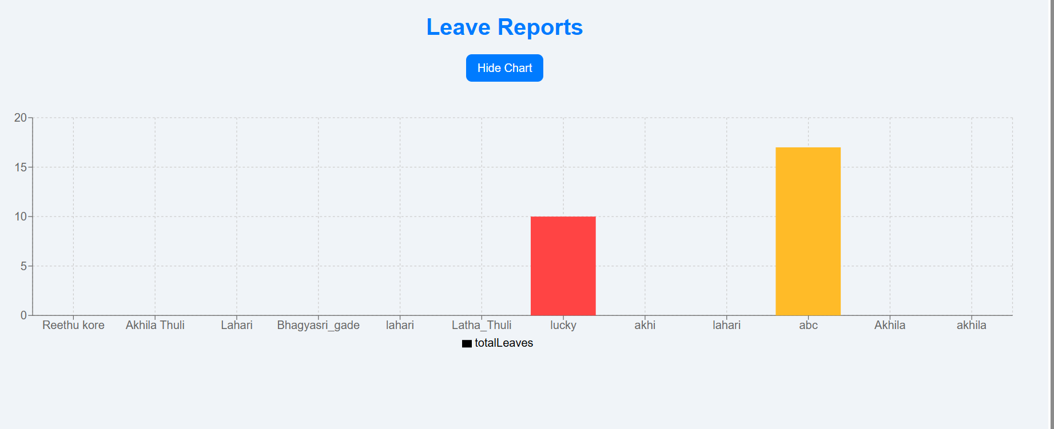
03
Leaves Tracking:

Slide 36
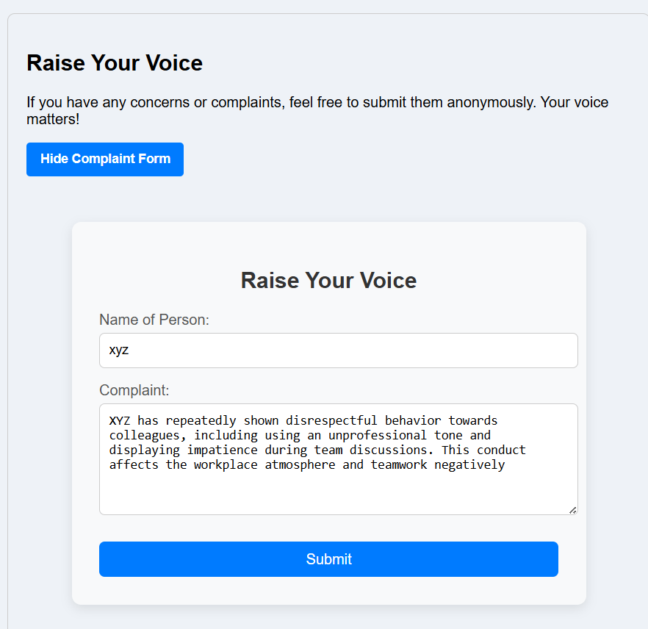
03
Complaints Module
Employee dashboard:

Slide 37
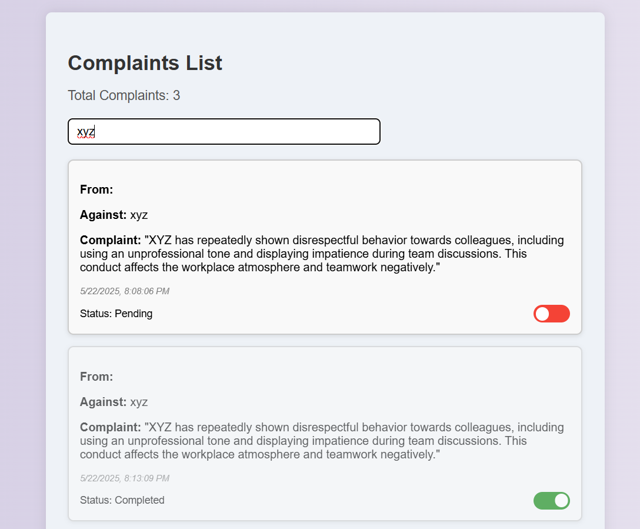
03
Complaints Module

Slide 38
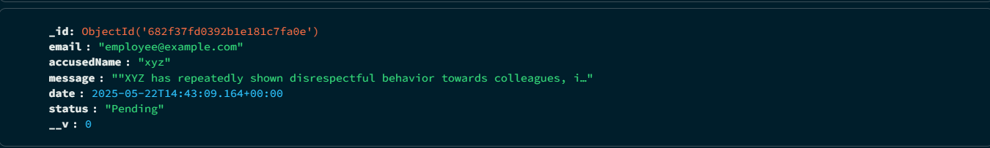
03
Complaints database:

Slide 39

Login
Modify Employee details
Leave Approval or Reject
Checks Resume
View Complaints
View Reports
View Feedbacks
Add
02
System Design - HR
Update
Delete

Slide 40
02
System Design - Employee
Login
Apply Leave and View status
Raise a Complaint
Give Feedback

Slide 41
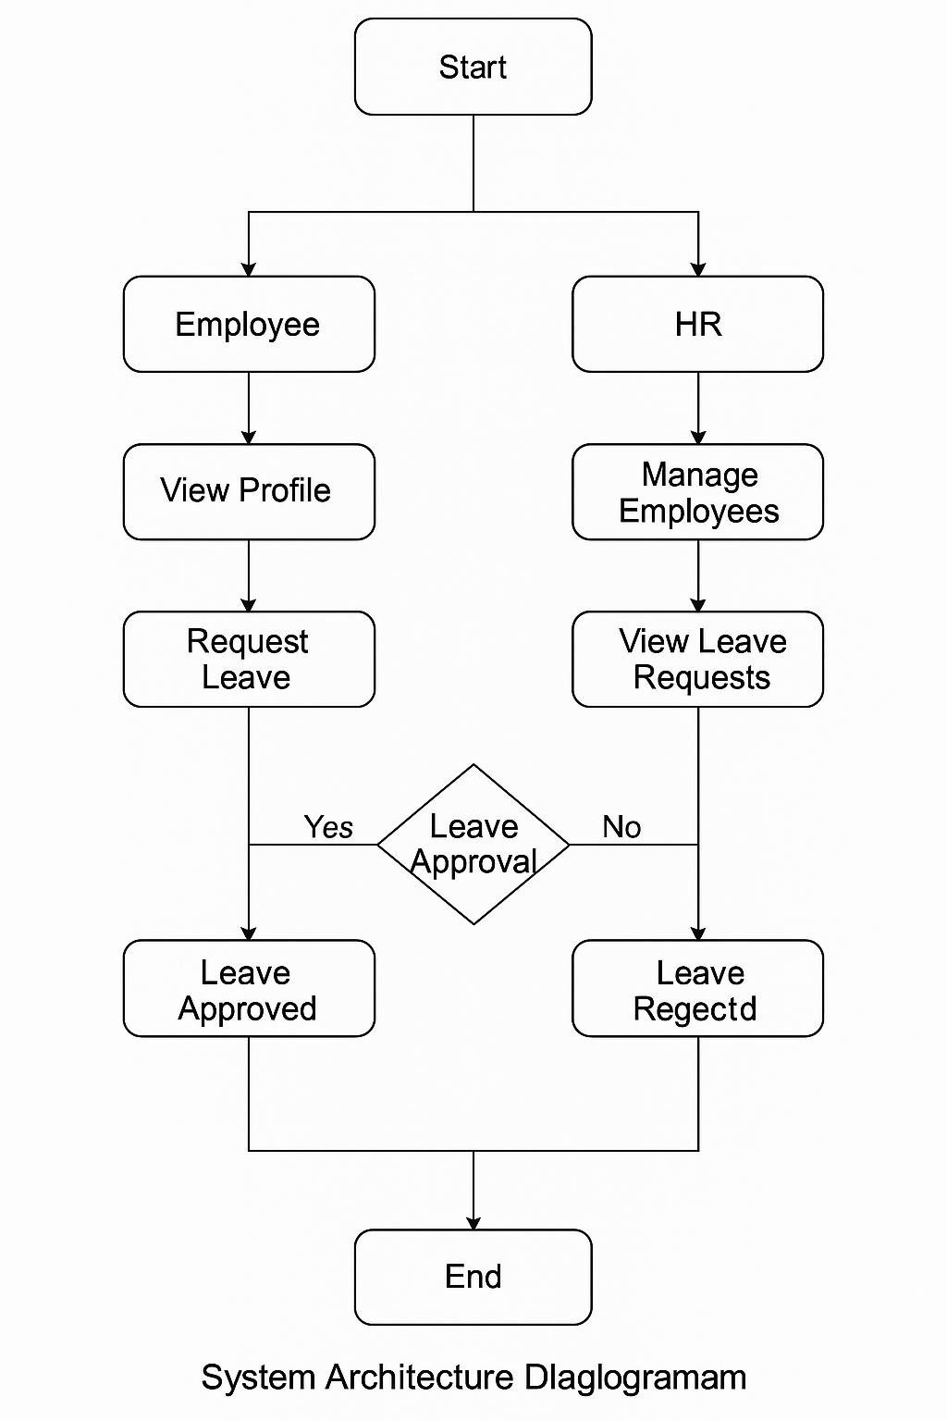
02
Flow Diagram

Slide 42
02
Future Scope
Develop mobile apps for Android and iOS platforms
Integrate AI to support smart HR decisions and performance insights.
Enable anonymous feedback in the Raise Your Voice section.
Migrate to cloud for scalability, real-time sync, and flexibility.
Use biometrics for secure and accurate attendance tracking.
Connect with payroll, ERP, and recruitment tools for seamless workflow

Slide 43
02
Conclusion
The STAFFEASE offers a comprehensive and efficient solution for managing employee data, attendance, leave, and performance.
By replacing manual processes with a digital system, it significantly reduces errors, enhances data security, and saves time.
This system not only streamlines HR operations but also improves transparency and accessibility for employees.
Moving forward, STAFFEASE has the potential to evolve with more advanced features and broader platform support, making it a scalable and valuable tool for any organization.

Slide 44


THANK YOU

